Slide 1


Progress and Challenges of Trade Facilitation in the Caribbean
ECLAC/ALADI REGIONAL TRADE FACILITATION SEMINAR
Montevideo, Uruguay 27 NOVEMBER 2023
Michele Lowe
CARICOM Secretariat

Slide 2

PRESENTATION OUTLINE
I: CARICOM TF Environment
Snapshot of TFA compliance
Drivers and Policy Imperatives
II: CARICOM TF Agenda & Strategy
Mandates & Objectives
Priority Regional Initiatives
Regional co-ordination
III: Score Card – Progress and Challenges

Slide 3
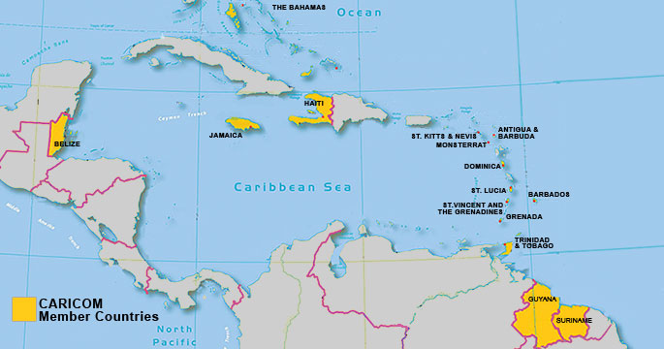
CARICOM TF ENVIRONMENT
Antigua & Barbuda
Barbados
Belize
Dominica
Grenada
Guyana
Haiti
Jamaica
St. Kitts and Nevis
Saint Lucia
St. Vincent and the Grenadines
Suriname
Trinidad and Tobago
Notes:
Small, open economies, with limited internal markets and sources of domestic investment;
Highly dependent on international trade and foreign investment.
Low trade performance in external trade agreements. Bilateral trade deficit with most BTA partners.
Market access opportunities from bilateral trade agreements frustrated by behind-the border barriers at trading partners’ frontier.

Slide 4
TFA COMPLIANCE IN CARICOM (on Entry into Force)
Source: Collated from WTO TFA Database
Notes:
- 11 of 13 WTO CARICOM Members have ratified the TF Agreement.
Wide variation in TFA compliance among CARICOM Member States.
Some countries have mainstreamed TFA implementation into national development plans and strategies, which is driving the reform process (e.g. Jamaica)

Slide 5
TFA COMPLIANCE IN CARICOM
Source: CARICOM Official notifications
Notes:
.

Slide 6
TFA COMPLIANCE IN CARICOM
Source: CARICOM Official notifications

Slide 7
TFA COMPLIANCE IN CARICOM
Source: Collated from WTO TFA Database
Notes:
CARICOM regional average pace is 58.1% . Reality on the ground may be different.
Some implementation delays and road blocks experienced – lag in legislation reform, lack of investment, slow mobilization of TACB support
Some countries have undertaken early implementation of commitments.

Slide 8
TFA COMPLIANCE IN CARICOM
Source: Collated from WTO TFA Database

Slide 9
KEY DRIVERS OF THE CARICOM TF AGENDA
ECONOMIC RESILIENCE
BUSINESS
TFA/BTAs
CSM
Notes:
Four main drivers
Community strategic goals – build economic resilience, competitiveness, attract FDI and participation in regional and global value chains
Commercial/Business – strong demand from traders – regional and extra-regional
CARICOM Single Market (CSM) – legal obligations of the Revised Treaty of Chaguaramas which recognize that a fully operational CSM and Free Circulation regime requires
Harmonised customs legislation and uniform import and export procedures benchmarked against international standards;
uniform quality standards and testing procedures (TBT and SPS);
uniform procedures regarding fees, charges and penalties;
Strengthened customs administrations and co-operation;
Supporting industrial policy
Reliable air and maritime transportation links;
International (third party) obligations (TFA/BTAs) – strong demand from trading partners to update the BTAs to facilitate trade through modern procedures

Slide 10
THE CARICOM TF AGENDA & STRATEGY
LEVERAGE TFA IMPLEMENTATION TO:
Support and drive regional integration and trade facilitation reforms through harmonised and co-ordinated actions.
Improve trade performance and enhance foreign market access;
Improve regional business environment; reduce time and cost of doing business.
Fulfil international obligations on Trade Facilitation (EPA, TFA);
Rationalise and co-ordinate donor engagement and interventions for ongoing trade facilitation reforms in CARICOM.
Harness regional expertise for TACB support;
Support the achievement of the Community’s strategic goal of Economic Resilience (improve competitiveness, attract FDI, integrate into regional and global VCs)
Notes:
CARICOM is leveraging TFA implementation to support and catalyse regional integration through the adoption of co-ordinated and harmonised trade facilitation reforms across Member States.
The Community is adopting a co-ordinated approach to implementation of the TFA guided by a regional strategy which aims to:
1. Support/drive regional integration efforts
2. Minimise/rationalize the cost of implementation of the TFA for MS through adoption of co-ordinated/harmonized approaches where feasible.
3. Co-ordinate mobilization of donor resources for TACB support. Rationalize use of scare donor resources

Slide 11
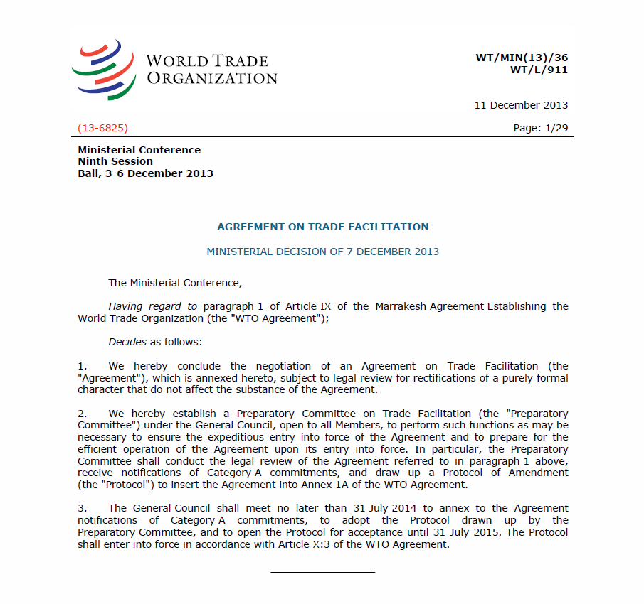
THE CARICOM TF AGENDA & STRATEGY
MANDATES
Prioritise co-operation on TF in bilateral arrangements with hemispheric trading partners;
Adopt a co-ordinated regional approach to TFA implementation ;
Utilise regional approaches, where appropriate, to minimise/rationalise TFA implementation costs;
Co-ordinate mobilisation of donor resources and TACB to support implementation;
Establish CARICOM Regional Committee on Trade Facilitation (RCTF) to oversee regional co-ordination;
CCS to monitor, provide support, and mobilise TACB support for national and regional implementation

Slide 12

CARICOM TFA IMPLEMENTATION STRATEGY Priority areas for TACB support
Transparency Provisions (Publication, Consultation, Enquiry points)
Test Procedures
Risk Management
Post Clearance Audit
Single Window
Advance Rulings
Authorised Economic Operators

Slide 13
REGIONAL APPROACHES
Initiative | Description/ Scope
Regional or Sub-regional Trade Information Portal | Transparency Publication of TFA-required information. Regional enquiry point
Regional Electronic Risk Information Exchange | Rapid and secure exchange of risk information.
Regional Risk Management System | assess regional-level threats and risks develop and communicate common risk criteria to CARICOM members monitor and evaluate results
Accredited Regional labs and testing bodies | Designate accredited laboratories in CARICOM region authorized to carry out confirmatory tests for goods imported to any CARICOM member

Slide 14
REGIONAL SUPPORT INITIATIVES
Regional Activities
Legal | Model harmonized legislation
Administrative/ Operational Support | Model harmonized SOPs Model harmonized forms + documents Guidelines for establishment/operation of national administrative bodies
Capacity Building | Regional training programs, sharing of experience and expertise and regional best practices.
Regional Coordination | Regional committees - monitor and provide technical guidance
Notes:
Regional support activities reduce national implementation costs and promote regional integration. These activities generally take a number of forms:
Development at the regional level of model legislation that can be used by each country – common legal basis to enable implementation of the TFA measure
Development of harmonized SOP’s, including standard forms to be used by all countries - common administrative/operational procedures or technical guidelines for implementation of the TFA measure
Common forms and data requirements
Common guidelines for establishment/operation of national administrative bodies responsible for implementation of TFA measures
Common capacity building programs for public administrations and private sector;
Regional committees to monitor and guide regional co-ordination.

Slide 15

INSTITUTIONAL FRAMEWORK
CARICOM REGIONAL COMMITTEE ON TRADE FACILITATION (RCTF)
Trade Ministerial Council (COTED) - Policy Oversight
CARICOM Customs Committee – Technical guidance on Customs Matters
CROSQ – Regional standards setting body
CAHFSA – Regional plant and animal health issues
NCTFs – National Co-ordination
OECS Commission – Sub-regional co-ordination
CARICOM Secretariat – Regional co-ordination
Notes:
Institutional framework for Regional co-ordination-
CARICOM Regional Committee on Trade Facilitation (RCTF) established in January 2019.
Oversees and guides regional co-ordination and implementation of the TFA within the Community;
Ensures coherence and consistency between national and regional trade facilitation priorities;
Facilitates public- private sector dialogue;
Provides an Institutional platform for sharing of experiences and best practices;
Identifies priorities for the mobilisation of donor support for approved regional projects and other technical assistance and capacity building (TACB) activities.
Monitors and tracks national implementation

Slide 16

SCORECARD
Regional harmonized policy and institutional frameworks to support TF – Customs, SPS, TBT, MASA;
Harmonised Regional quality infrastructure;
Some advances in the automation and digitalization of trade procedures and documents;
OECS Economic Union reform initiatives;
Regional Co-ordination – Monitoring; TACB mobilization; Information and experience sharing through the RCTF;
SOME PROGRESS…

Slide 17

SOME HEADWINDS….
Slow legislative reform process in Member States
Infrastructure investment (ICT, risk assessment including certification bodies and testing labs etc.)
Border Agency co-ordination
Regional Transportation infrastructure and connectivity;
CSM implementation gaps
Public-private dialogue and Private Sector engagement
National co-ordination and monitoring of commitments (NTFCs);
Donor engagement.

Slide 18
Thank You!
michele.lowe@caricom.org
www.caricom.org

